Slide 1
SM & CR Training
Senior managers and Certification Regime
Training for clients

Slide 2
Background
“If firms don’t change their mindsets ... old habits ... will repeat themselves and we will see poor outcomes for consumers, poor outcomes for firms ... poor outcomes for markets and the industry with continued erosion of trust and reputation”
Jonathan Davidson, FCA Director of Supervision, 12 July 2016
The above quotation from the FCA’s Director of Supervision describes the Financial Crisis of 2007/2008
There are many reasons behind the Financial Crisis, however regulators consistently agree that the ‘Accountability Framework’ within our Financial Services firms was a key issue, giving rise to the potential of not only fraud and lack of professionalism, but also a repeat scenario in future!
During this time we were (and still currently are) under The Approved Persons Regime and a code of conduct but many still feel this is inadequate. Industry regulators feel that there is still a sense of accountability on too small a population within the industry making it difficult for the regulator to identify who within a firm is responsible for a particular aspect of that organization's activities.

Slide 3
Next Stages
The government set up a Parliamentary Commission to look into banking standards, including the level of individual responsibility within the Industry. This led to both the Financial Conduct Authority and the Prudential Regulation Authority introducing the Senior Managers and Certification Regime.
The SMCR places greater responsibility on those individuals (The Approved Persons) managing a firm, and also requires firms to take more responsibility for employees being fit and proper to perform their roles by introducing standards of conduct at all levels.
2016
Introduction of the SMCR for banks, building societies, large investment firms and other significant organisations
2018
Introduction of the SMCR for Insurance Companies
9th December 2019
Introduction of the SMCR for all other FCA regulated firms.
The extension of the SMCR into FCA regulated organisations will align these standards to all financial services firms in order to restore confidence in the industry. This will also create a culture of greater accountability for approved persons within an organisation.

Slide 4
Approved Persons Regime → SMCR
Current Approved Persons regime will be replaced by the Senior Managers Regime for the highest ranking management
The Certification Regime will apply to the same individuals under the Approved Persons regime, and probably more, as roles with specific qualifications will now be caught under the new regime. (An example of this is an accountant – who will hold the necessary certifications to carry out their role)
Senior Managers will be created and they will have clear individual responsibilities and accountability (much more stringent than under the current regime)
Firms will take responsibility for the certification (and assessing fitness and propriety) of those staff caught under the regime.
There will be a new Duty of Responsibility for Senior Managers, making them more accountable for regulatory breaches in their business areas.
A new code of conduct rules will apply to almost everyone in the firm.

Slide 5
SM & CR – The Three Components
Senior Managers Regime (SMR) – this focuses on people like the Executive Committee or Board, who hold key roles or have overall responsibilities for whole areas of relevant firms.
Certification Regime – this applies to functions that the performance of, could pose a risk of significant harm to the firm or any of its customers.
(e.g. local operations where regulated products are sold…)
Conduct Rules – these are high level requirements that hold everyone working in The Firm (except ancillary staff) to account.

Slide 6
Senior Managers Regime
New Senior Management functions (SMF) to replace existing controlled and significant influence functions.
Senior Managers are required to have a Statement of Responsibilities, detailing what they are responsible and accountable for within the business.
Senior Managers also have a Duty of Responsibility and must act with due care to mitigate the risk of any breaches or non-compliance.
Prescribed Responsibilities as required by the FCA for firms to allocate.
Senior Members of staff are to be approved by the FCA and The Firm has a responsibility to ensure that individuals are “fit and proper” – This will require staff to complete the annual assessment form.

Slide 7
SMF Governing Functions for the Firm
For AR/limited permissions there are 3 possible roles to fill:
SMF16 Compliance Oversight
SMF 17 Money Laundering Counter measures
SMF29 Limited Scope Function
Note: where only CF8 (now SMF 29) was in place, there is no need for the additional roles to be added now.
For Authorised Firms there are 5
SMF1 CEO
SMF3 Executive Director
SMF9 Chair
SMF 16 and 17 as above
Non Execs will no longer be FCA registered; same applies that roles not required under the CF regime are not needed now unless there are significant changes.

Slide 8
FCA Action
As a Senior Manager, there is a Statutory Duty of Responsibility. If the business breaches a regulatory requirement and you are the Senior Manager responsible for the area in question, then you could be held accountable.
You must take reasonable steps to prevent regulatory breaches including:
Appropriate assignment and supervision of tasks
Effective management of staff
Ensuring internal policies and procedures are up to date
Completing all Regulatory Filings
Action against a Senior Manager by the FCA will be determined by:
The seriousness of a breach
The person's position and responsibilities
The need to use enforcement powers effectively and proportionately.

Slide 9
SMF Statements of Responsibilities
You must have a Statement of Responsibilities (SoR) clearly setting out your responsibilities in a single document (even if you are performing more than one Senior Management Function.)
SoR will consist of two separate component's; Prescribed Responsibilities and Overall Responsibilities.
Prescribed Responsibilities
These are specific responsibilities that a firm must allocate amongst its SMF roles.
These are specifically prescribed to ensure that a Senior Manager in SMF roles are accountable for key conduct and risks and therefore must be taken on by the most senior person responsible for that activity or area.

Slide 10
SMF Overall Responsibilities
Other Responsibilities encompass business functions and activities, in addition to the Prescribed Responsibilities for which a Senior Manager is accountable. This includes both regulated and unregulated business.
The firm must determine which Other Responsibilities are appropriate, given the responsibilities of each Senior Manager.

Slide 11
Competence and Capability
Senior Management within The Firm must demonstrate and be able to evidence the skills, knowledge and experience, in order to perform their roles. The Firm will look at any Senior Management staff and consider whether:
All applicable training and competence requirements have been completed (in relation to the function they perform or are going to perform)
The member of staff has demonstrated by experience and training that they are suitable to perform the Senior Management function intended.
They have the adequate time to perform the function in question and meet the responsibilities associated with their role.

Slide 12
Certification Regime
The Certification Regime captures those individuals who are not Senior Managers, but whose jobs could cause significant harm to the business and customers.
It may impact upon Senior Managers for the following reasons:
a Senior Manager may be conducting one of more of these functions as well as conducting senior management functions
a Senior Manager may be supervising individuals subject to the Certification Regime
performance by the firm of its obligations under the Certification Regime is also a Prescribed Responsibility under the SMR
Functions relevant to The Firm are:

Slide 13
Certification regime (cont’d)
Significant Management CF
Individuals with significant responsibility for a business unit. These important roles can seriously impact the way a firm conducts its business and are not limited to revenue-generating business areas.
Functions subject to qualification Requirements
Functions subject to qualification requirements in the Training and Competence Source book. Individuals must hold the necessary qualifications in order to carry out their role.
Anyone who supervises or manages a Certified Function
This covers anyone who supervises or manages a person within a CF role, but is not a Senior Manager. This designation ensures that individuals who supervise employees undertaking a CF are held to the same standard of accountability. It means that there is a clear chain of accountability.

Slide 14
The Certification Level
The definition is what roles are in scope. The SMF roles will be responsible for deciding who they are.
This will depend on a range of factors including distribution network, influence of each leadership role and customer impact.
Those in Certification Level roles will need to be entered on The Directory between 9.12.19 and 9.12.20 – this details the firm and the staff
https://www.fca.org.uk/publication/policy/ps19-07.pdf

Slide 15
Requirements for Certified Staff
Certified staff must be registered with the FCA, but do not need to be pre-approved.
The Firm has to complete an initial assessment and provide a certificate to each employee holding a CF. The initial assessment must be completed by the 9th of December 2019.
CF holders will then be re-certified at the end of each year which will form part of the existing annual review process.
As with Senior Managers, The Firm will need to conduct Regulatory References prior to employing anybody taking up a CF.
Certified Staff are subject to the Conduct Rules.

Slide 16
‘Fit and Proper’ Framework and Referencing
In order to protect the business reputation and also ensure that those with significant management roles are reliable and fit to discharge their responsibilities effectively, The Firm will carry out a number of checks on those coming into relevant roles including:
any criminal convictions and offences
civil proceedings
regulatory issues (enforcement action, being the subject of a successful complaint, fraudulent activity)
previous disciplinary investigations
director disqualifications and other issues such as a company going into administration whilst the individual was a director

Slide 17
Financial Soundness
When Appointing Senior Management, The Firm will consider the persons financial soundness and whether it could impact upon their ability to perform the role. This includes considering outstanding Judgment debts and bankruptcy proceedings.

Slide 18
FCA References and Checks
The FCA requires Regulated businesses to perform the following checks on members of the Senior Management Team:

Slide 19
Criminal Background Checks
Internal staff moving to an SMF role and external candidates must declare if they have a criminal record
The Firm must verify that the information provided by a SMF candidate is true
The Firm will need to be registered with the Disclosure and Barring Service
Consideration would need to be given as to whether extra criminal record checks are needed for non-UK based SMF roles

Slide 20
The Firm Referencing Checklist

Slide 21
All staff - Conduct Rules
The Conduct Rules seek to ensure a single standard applies across the market, and should help to shape a firm's culture, standards and policies.
This is a new requirement, representing a meaningful change in the standards of conduct expected from those working in the financial services industry.
There are two sets of basic rules which apply to employees. The first being for all staff, and the second tier for Senior Management.
Tier 1 | Individual Responsibility
CR1 | You must act with integrity
CR2 | You must act with due care, skill and diligence
CR3 | You must be open and co-operative with the FCA, PRA and other regulators
CR4 | You must pay due regard to the interests of customers and treat them fairly
CR5 | You must observe proper standards of conduct

Slide 22
Tier 2 | Senior Management Conduct Rules
SM1 | You must take reasonable steps to ensure that the business of the firm for which you are responsible is controlled effectively
SM2 | You must take reasonable steps to ensure it complies with all the relevant requirements and standards of the regulatory system
SM3 | You must ensure that any delegation of your responsibilities is to an appropriate person and that you oversee that delegation effectively
SM4 | You must disclose appropriately any information of which the FCA or PRA would reasonably expect notice
Firms must train employees to understand how the conduct rules are relevant to their individual roles. A Senior Manager will be personally responsible for ensuring compliance with this
Firms must report disciplinary actions taken due to a breach of the conduct rules to the FCA. This must be completed within seven days for Senior Managers, and on an annual basis for all other employees
SMF and Certification Regime employees will need to be trained and abide by the Conduct Rules from the start of the new regime but firms will have a further 12 months to train their other employees on the Conduct Rules.

Slide 23
Notifying the FCA when…..
There are specific instances when the FCA must be notified within the Senior Managers Regime, including where FCA pre-approval is required.
Performing an SMF role for the first time:
If you are performing an SMF for the first time after 9 December 2019, you will require FCA approval. The Firm will need to submit:
An Approval form (which includes a ‘fitness and propriety’ questionnaire)
A Statement of Responsibilities (SoR) which must be approved by the FCA before starting the role
Other documentation, including a CV, GAP Skills Analysis, Induction Program, T&C plan and information on how competency was assessed.
On the 9 December 2019, existing Approved Persons are converted to the new SMFs. However, The Firm must have completed and submitted to the FCA a Statement of Responsibility for each Senior Manager in advance)
The FCA must also be notified if there are any significant changes to the responsibility of a SMF holder or if an individual will cease to hold a SMF.

Slide 24
The FCA must also be notified If The Firm takes disciplinary action against a SMF holder, which is defined by the FCA, as:
a formal written warning
suspension or dismissal
reduction or recovery of remuneration
The Firm must notify the FCA within seven business days or in serious instances or breaches of conduct, one business day.

Slide 25
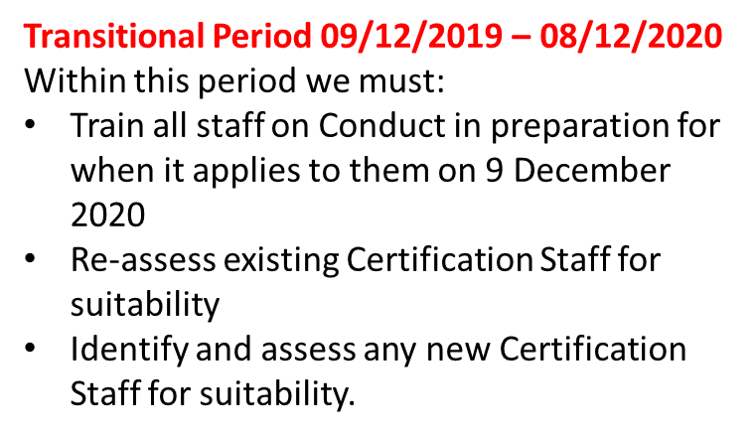
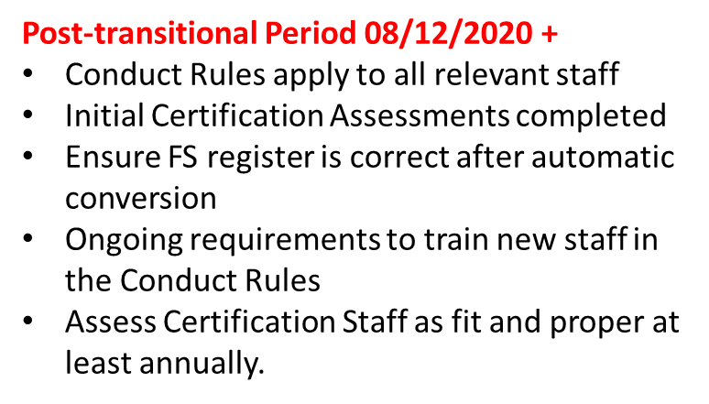
Timeframes

Slide 26
Questions
Please refer any questions to iComplyonline Ltd

